Slide 1

Learning Math with Robots for Elementary
School
By
Dr. Pedro Ponce
ITESM-CCM pedro.ponce@itesm.mx

Slide 2
Main Goals
To develop a complete platform based on hardware and software which covers the entire elementary math program.
  Easy to learn, use and implement.
  All the math topics of elementary school have to be covered based on the official Mexican program.
The platform will include special material for disabled kids.
The students will learn different skills.
The platform provides the world with more tools for basic math education.
  No advanced knowledge of Robots or LabVIEW is required

Slide 3
The Students gain new skills
Not only is a simple program pretty well design for math in
which the student could spend a lot of time, but also they
could develop new skills as:
Team Work (change to different roles inside the team)
Propose new examples
Learn how programming
Learn hardware and software at the same time

Slide 4
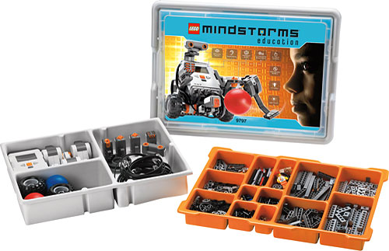
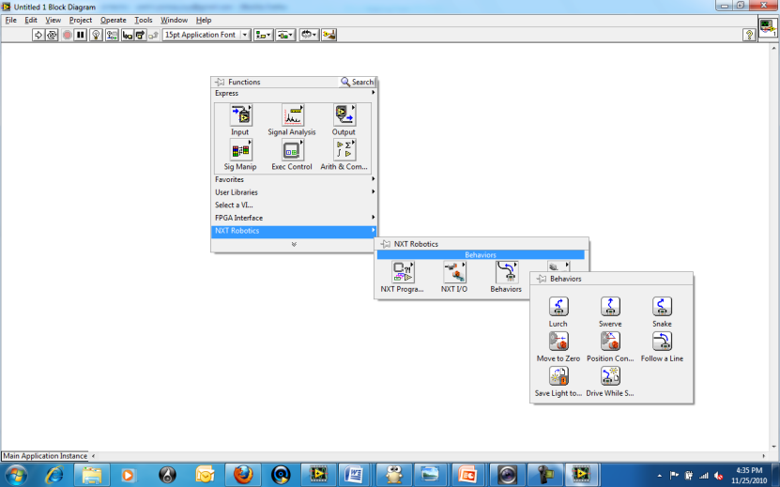
Robots & Education….
Using robots in education is not a fresh idea but now there are new tools that could be included for improving the kids math knowledge, so robots used in educations are necessarily.

Slide 5
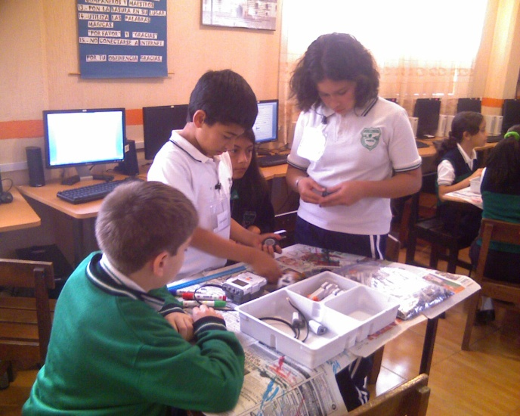
Kids work on Robots

Slide 6
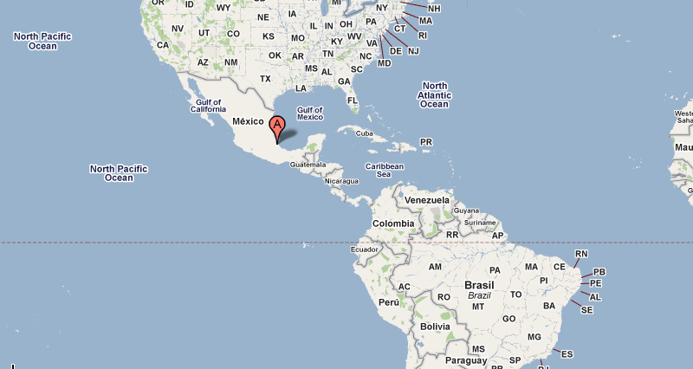

Xalapa Ver.
Capital of Veracruz state.
year 2005 census the city reported a population of 387879

Slide 7
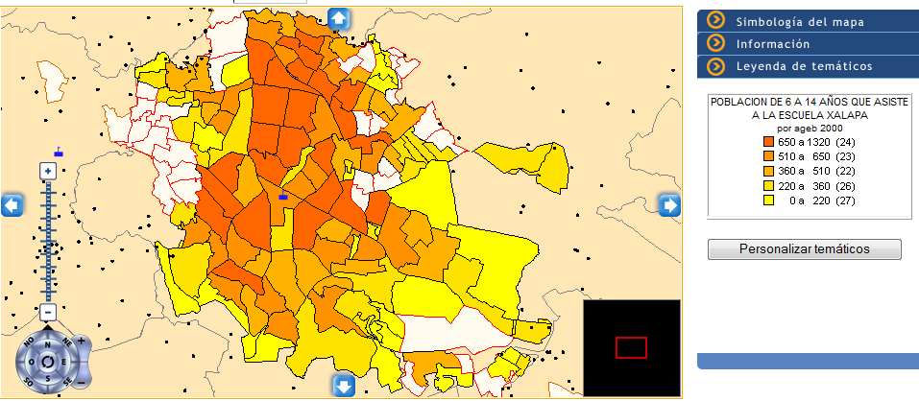
202 Elementary Schools in Xalapa

Slide 8


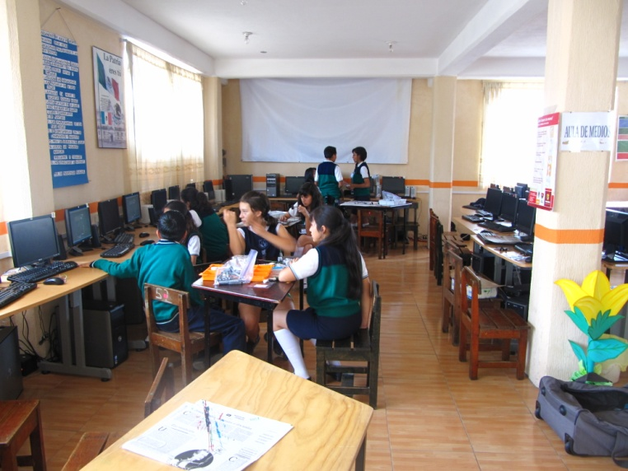
Who’s Behind Robots for Education project
Elementary School
Acela Servín Murrieta
In Xalapa Ver.

Slide 9
National Instruments Profile
More than 110 Countries
Corporate at Austin, Texas
More than 30,000 companies use LabVIEW
Adopted in 6,000+ universities worldwide
Used in all engineering and science disciplines
Direct sales offices
Distribuitors
Notes:
Headquartered in Austin, Texas, NI has more than 3,700 employees and direct operations in
40 countries. In 2004, NI sold products to more than 25,000 different companies in more than
90 countries around the world.
Along with the multitude of measurement and automation tools that we offer, NI recognizes more than 600 members in our National Instruments Alliance Partner Program (a network of independent consultants and integrators), who are ready to assist you in assembling and implementing an NI measurement and automation solution. These Alliance Partners represent domain expertise in many fields including aerospace, automotive, electronics, communications, and semiconductor.

Slide 10
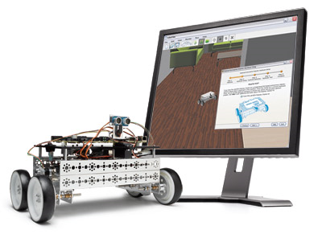
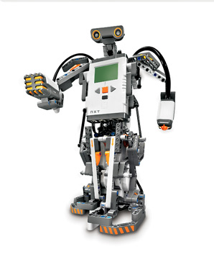
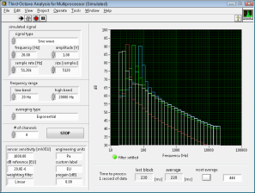
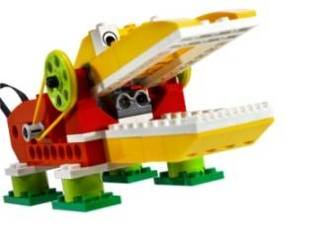
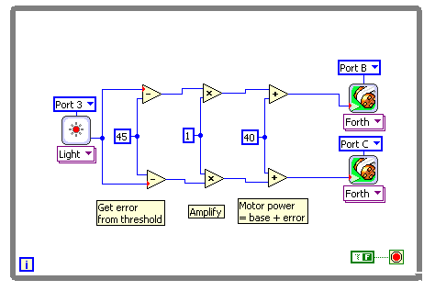






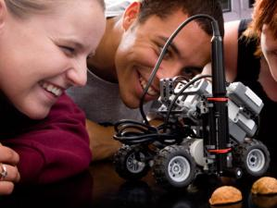

LabVIEW: From K-12 to Rocket Science!
LabVIEW Robotics
LabVIEW Education Edition
LEGO ® MINDSTORMS® NXT
powered by LabVIEW
LEGO ® WeDo®
powered by LabVIEW
Kindergarten – 8
High School
University
Industry
Notes:
LV EE needs to be targeted at

Slide 11
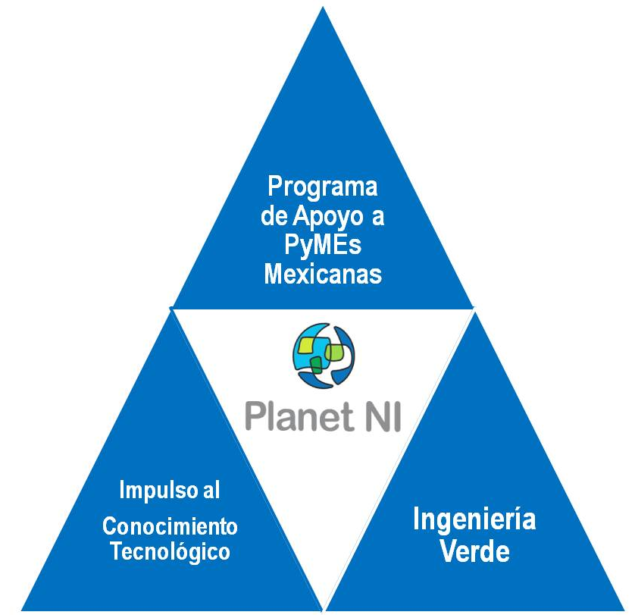
Planet NI
Planet NI is an initiative designed to empower engineers and students in developing countries to achieve economic prosperity and sustainable development through technology access and education.
  Empowering engineers in developing
  countries to achieve economic prosperity .
  through access to technology.
Notes:
¿Qué es Planet NI?
Es una iniciativa de National Instruments diseñada con la meta de ayudar a mejorar la calidad de vida y el éxito de los países en vías de desarrollo a través de educación y el uso de tecnología.
Misión de Planet NI
“Trabajando para apoyar a los países y sus comunidades en vías de desarrollo para lograr prosperidad económica y crecimiento a través de la tecnología de National Instruments”

Slide 12
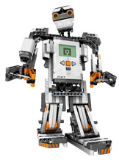
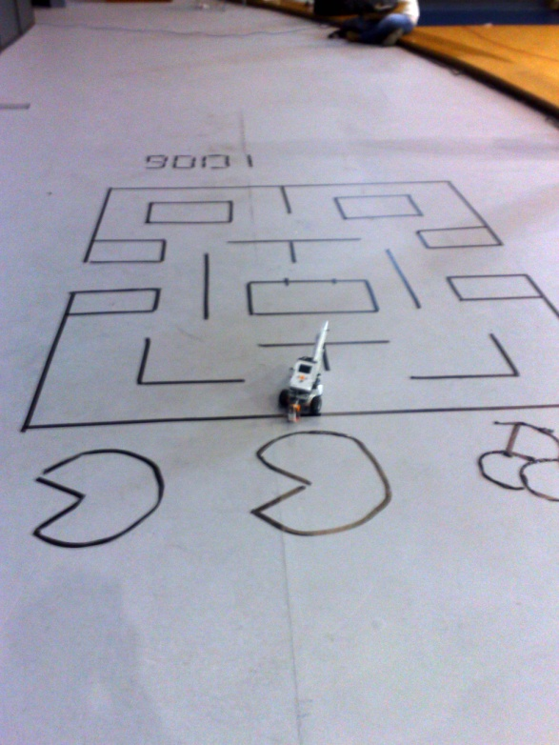
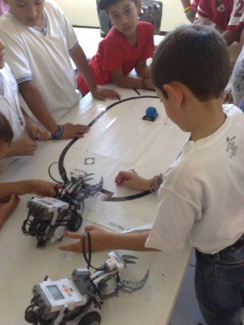
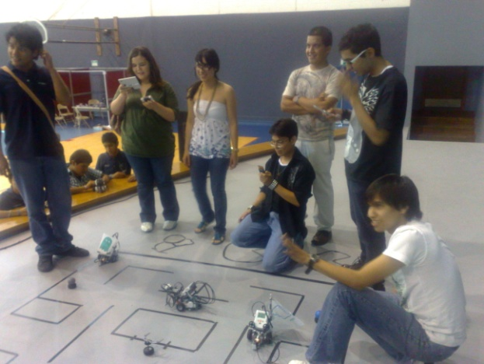
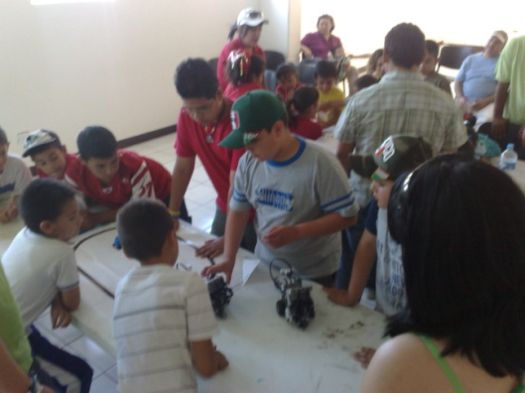
Impulso al Conocimiento Tecnológico
“Promote the learn and use of technology among children, youth and educational institutions providing traininig and support of National Instruments products”
Benefits
  Training to people focused on this type of program
  Support contests, institutions, museums, groups and institutions which promotes the use of technology among children and youth

Slide 13
Support for the elementary school
Train the teachers with LabVIEW
Loan of LabVIEW Education Edition License for six months
Monitoring activities
Support competitions
Provide material

Slide 14
Quote
202 orders:
Part Number:780001-25
LabVIEW Education Edition 25 Seat License
$22,440.00 MXP per package

Slide 15
Who’s Behind Robots for Education project
Elementary School tests and validates the platform and gives ITESM feedback about the new platform improvements.
ITESM designs new exercise using software and hardware as well as enhances the whole system.

Slide 16
Platform most important parts
Implementation
Action
The students use the robots and programs for learning math.
The students run the exercises using the robots.
The Students answer the exam that is running in the computer.
According to the students grades, the system designs new questions to improve the results; the system asks the student to run again the exercises and sends a complete report with the statistics to the teacher.
Learn
Test
Exam
Feedback

Slide 17
Step one
The students and the teacher watch a video about the selected topic that gives the general directions

Slide 18
Step two
The students read the instructions and assemble the robot.
The robot has to be connected to the computer for downloading the program.
The robots run the preloaded program.

Slide 19
Exam
After the students finished the exercises, an individual exam is shown on the computer. The exams includes an intelligent system which decides if the kid needs more exercises.

Slide 20
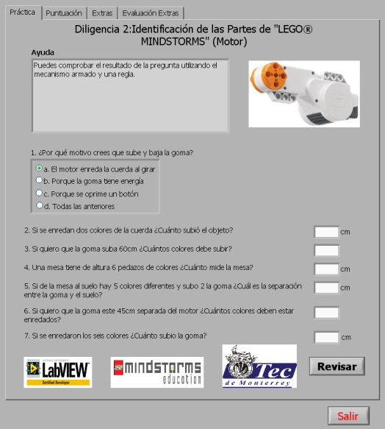
Exam about the math topic

Slide 21
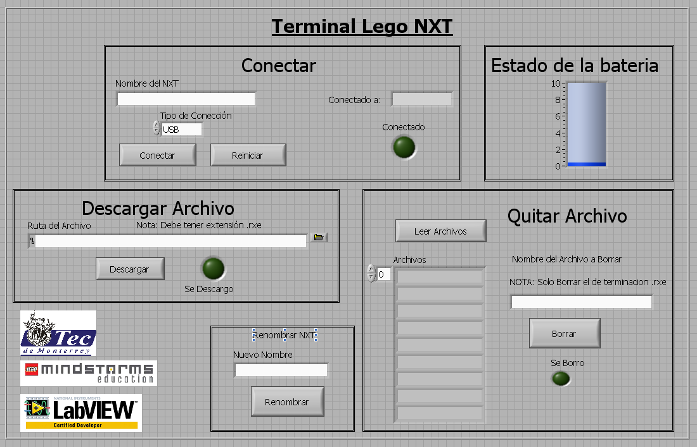
Frontal panel

Slide 22
Feedback
The grades are shown and new exercises has to be done by the students to improve the math knowledge.
A statistic report is sent to the teacher’s computer for taking decisions about what it will be the next task for the students.

Slide 23
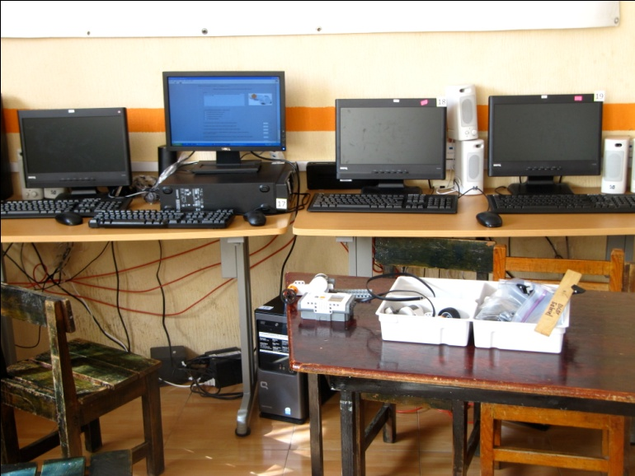
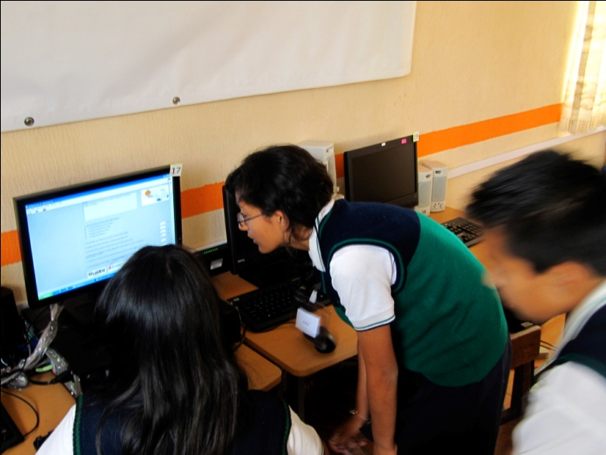
Computer Room and students

Slide 24
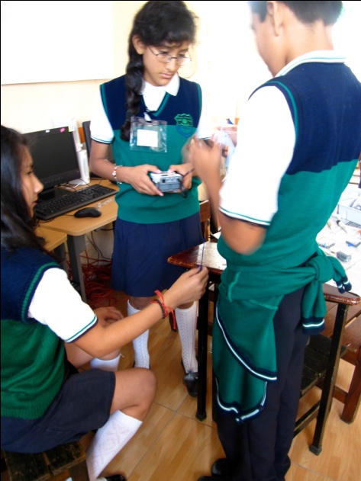
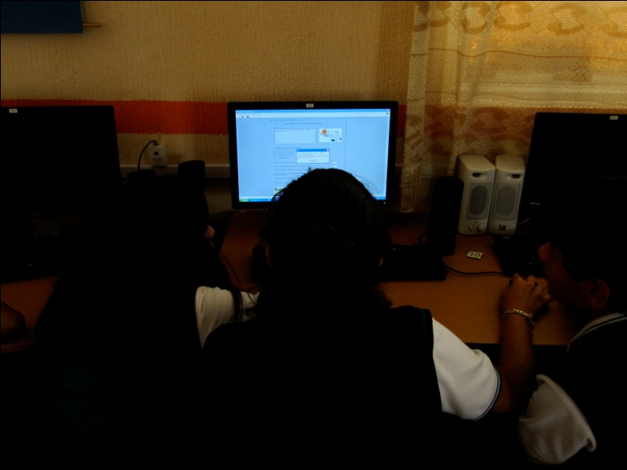
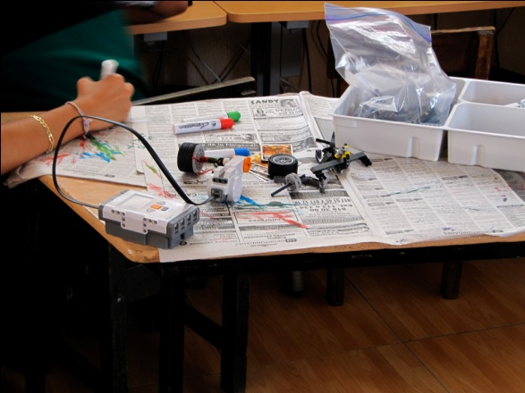
Case Study
Students Reading the directions
Assembling the robots

Slide 25
Partial Summary
The kids are more interested in learning math
The kids loves new math challenge using robots
The computer lab is used more than ever
The teachers are not afraid of new technology because is very easy to understand
The teachers are confident about LabVIEW programming using Lego

Slide 26
Future Work
Complete, test and validate the math program (for 1st and 2nd year) using Wedo system
To include exercises for special kids

